Slide 1

CryptoPulse
Real-Time Cryptocurrency Tracker
Team: Sableye | Github: archangel2006 | Discord: archangel.2006

Slide 2
Why We Built This
💰 There are many crypto trackers out there, but most are cluttered, ad-heavy, or overly complex.
🐍 We wanted to build a simple, real-time crypto tracker purely in Python — using Streamlit and CoinGecko API.
🌐 Our goal: Keep it clean, responsive, and beginner-friendly for those just starting out with crypto or data dashboards.

Slide 3
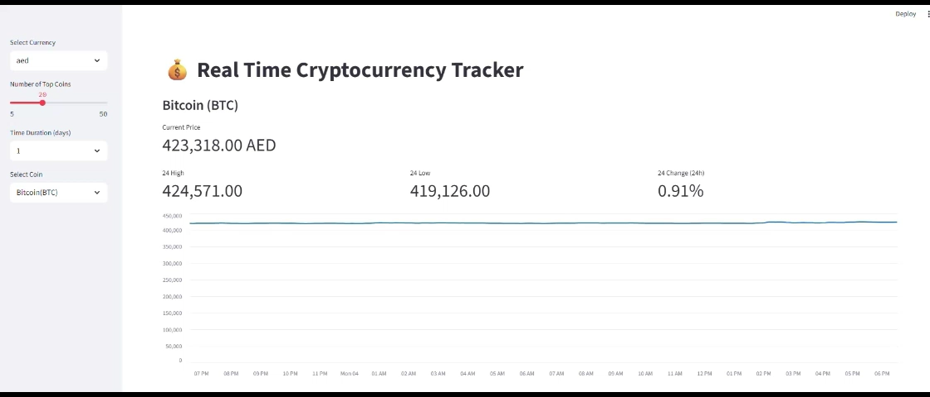
DEMO

Slide 4
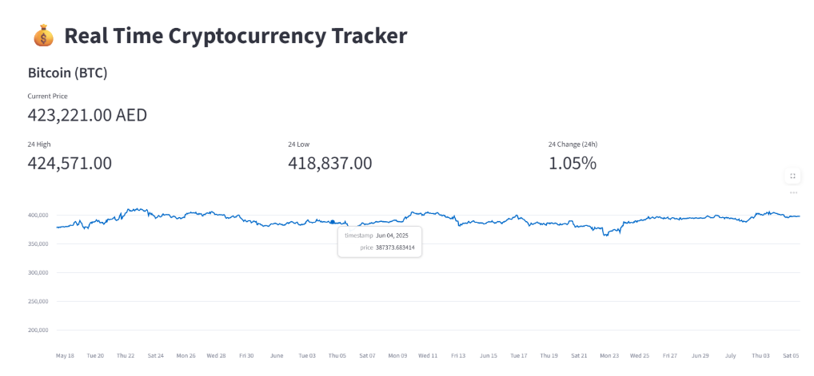
Features

Slide 5
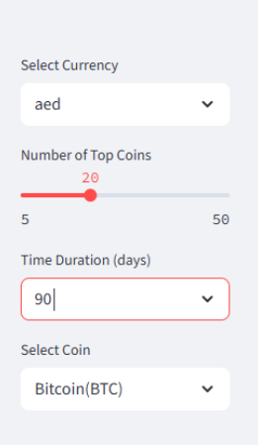
Features
Feature | Description
🔄 Live Crypto Data | Fetches real-time prices from the CoinGecko API
🌐 Multi-Currency Support | Dynamically loads all supported fiat currencies
⏳ Adjustable Duration | View price history over 1 day, 7 days, 30 days, or more
🏆 Top Coins Slider | Choose how many top coins to display (5–50)
📊 Interactive Line Charts | Visualize historical prices with clean Matplotlib charts
🚀 100% Python | Built entirely in Python — no HTML/JavaScript used
✅ Responsive UX | Minimal, clean UI with easy-to-use layout in Streamlit

Slide 6
THANK YOU
Team: Sableye | Github: archangel2006 | Discord: archangel.2006

